Slide 1
PRESENTATION OF ML DONOR ASSIGNMENT

Slide 2
TABLE OF CONTENTS
Data Exploration (EDA)
Data Cleaning
Missing Data
Binarisation/Get Dummies
Feature Selection
Classification/ Performance Measurements
Commercial Value

Slide 3
Data Exploration
After loading the data, a histogram was created to show the distribution of the different variables. Data Exploration was carried out to find out a few things such as :
How many people donated and how many didn’t
The relationship between the target variable (donation) and donor gender
The relationship between home ownership & donation
The distribution of the donors ages
The relationship between the donor’s genders and their income groups
The relationship between where donors lived and their likelihood of donating
The relationship between social economic status and donation
The overall gift amount given by donors
The things we wanted to compare and verify to see if true

Slide 4
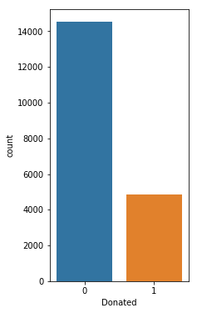
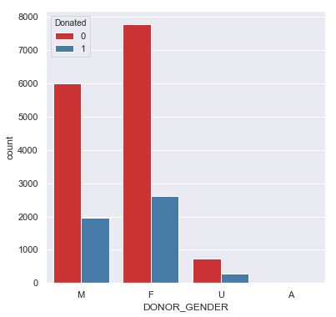
Data Exploration
Here we can clearly see that the number of actual donors is quite small
This graph shows us that a significant portion of the male and females fall as non-donors with the females slightly donating more
0 14529
1 4843

Slide 5
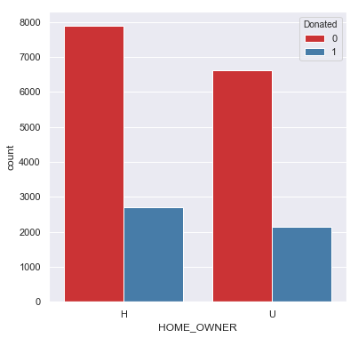
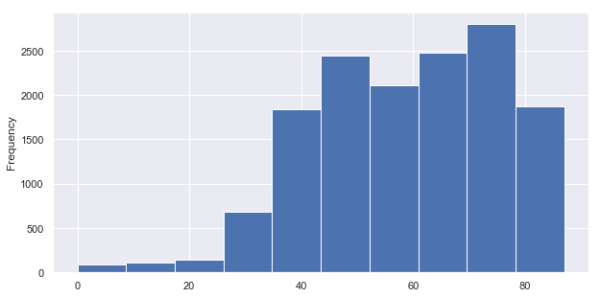
Data Exploration
This shows us the distribution of our donors and that most fall between the ages of 40 and 80, a demographic we can target for card promotions because they are in the twilight of their careers
This graph shows us that home ownership is an indicator that people will donate

Slide 6
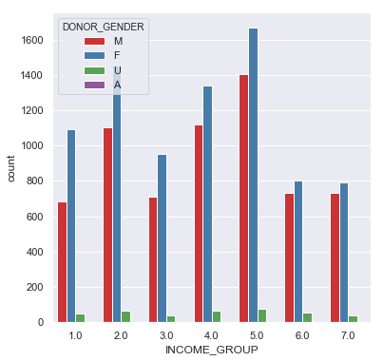
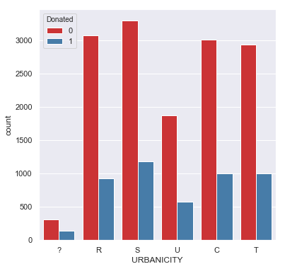
Data Exploration
We found out most people living in suburban areas (S) are most likely to donate. This makes sense as Suburban homeowners usually fall between the older demographics as we’ve seen in the age distribution
This shows us that across all income groups females out earn the males. We can conclude they’ll make a good group to target

Slide 7
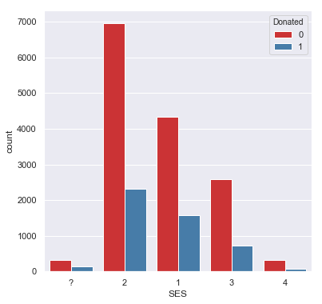
Data Exploration
This shows us the people most likely to donate fall within the second social economic grouping

Slide 8
Data Cleaning/Missing Data
With regards to data cleaning, there were a few columns with missing values such as donor age, income group, wealth rating and months since last promotion response. These columns were looked at individually and cleaned based on distribution of each of the features to make sure an appropriate value was put in(mean for normal dist. Median for skewed, mode for categorical etc.)
There was also the need to deal with miscellaneous variables, that is, figures like “?” or “ .” that were in the columns as values
The next step was to handle the categorical data. For most columns with categorical data, label encoding was employed on them
For the age column, one-hot encoding was employed to bring out the Male & Female columns

Slide 9
Feature Selection
For this stage, first the data was transformed through label encoding before variable selection.
For variable selection, a number of techniques were employed and the best was picked based on a voting system. The techniques used were Weight of Evidence & Information Value, Variable Importance, Recursive Feature Elimination, Chi Square, L1 Feature Selection and Random Forest.
After the voting and final selection, Multicollinearity was carried out on the final selected variables/

Slide 10
Classification/ Performance Measurements
After train test split, a number of models were evaluated on their scores. They were:
Stochastic Gradient Descent Learning: 74.85%
Random Forest: 100%
Logistic Regression: 74.9%
KNN: 81.46%
Naïve Bayes: 73.54%
Perceptron: 74.72%
Linear SVC: 69.16%
Decision Tree: 100%

Slide 11
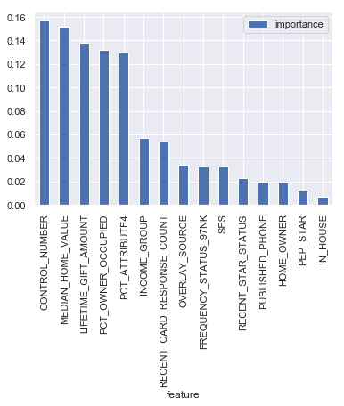
Classification/ Performance Measurements
Cross validation was then carried out along with a graph depicting feature importance of the selected variables

Slide 12
Classification/ Performance Measurements
Random Forest was the model picked as the best from the other models run. When the accuracy train and test were run together, there was a score of 1.0 and 0.75, a disparity pointing to overfitting of the model. To remedy this, hyper parameters endemic to the model Random Forest were deployed to fine tune the model, this left us with an accuracy train & test of 0.74 & 0.75 respectively.
The data was then scored using the PROSPECTIVE DONOR FILE which was loaded into the Jupyter notebook file. This data was first cleaned and then the relevant columns were selected

Slide 13
Commercial Value
The commercial value of the donors was determined using one of the columns – the TARGET_D column which according to the dataset is defined as “Response amount to 97NK solicitation”. This means the amount each donor that donated actually gave. Using the describe() function in pandas, the mean of this column (their contributions) was found to be 15.62. This was rounded up to 16. A 100 random actual donors from the data were picked & this number was multiplied by 16 giving us a total commercial value of $1600 per 100 donors.

Slide 14
THANK YOU

